Slide 1
Retail Giant Sales Forecasting
Time Series Deliverables
Group Members:
Naveen Masali
Sagar Sheth
Nikhil Tiwari

Slide 2
Global Mart
Online store super giant having worldwide operations,
Orders and delivers across the globe.
Deals with all the major product categories segments
Consumer.
Corporate.
Home office.

Slide 3
Operations
Operations in following market sectors
US
APAC
EU
Africa
EMEA
LATAM, &
Canada
Operates across following market segments
Consumer,
Corporate, &
Home office.

Slide 4
Assignment
Problem Statement
Need to finalise plan for the next 6 months.
Need to forecast the sales and the demand for the next 6 months so that revenue and inventory can be managed accordingly accordingly.
Key tasks
Understand and prepare the data for analysis
Craft time series on Sales and Quantity for future forecasts
Identify 2 most profitable and consistently profitable segments
Forecast and assess its accuracy.

Slide 5
Methodology
Data Understanding
Methodology
51290 order transaction record with 24 attributes
Data of 7 sectors, 3 market segments and 3 product categories
Data includes order detail, shipping details, and Profitability details
Classical decomposition
Auto Arima
Data cleaning and aggregation
MAPE accuracy and forecasting

Slide 6
Profitable Segments
Segments
Profitable segments are:
Consumer – APAC
Consumer - EU
Segment Features and Selection
The most profitable and consistent are selected based on sum(Profit) aggregation on Month and calculating the coefficient of variation.
Consumer – APAC and Consumer- EU were two of the most high profitable and relatively low Co-efficient of variance.

Slide 7
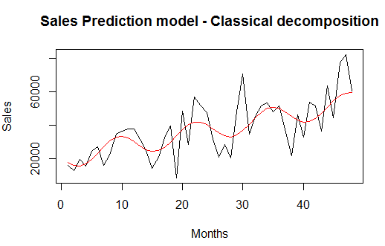
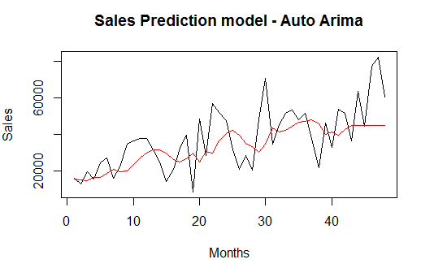
Sales Revenue Time Series (Consumer APAC)
For Consumer APAC, the sales prediction follows a wavy pattern.
The time series follows a increasing sales trend with random seasonality.
The classical decomposition model built for this has a MAPE value of 21.03181.
For Auto Arima, the MAPE value is 27.68952

Slide 8
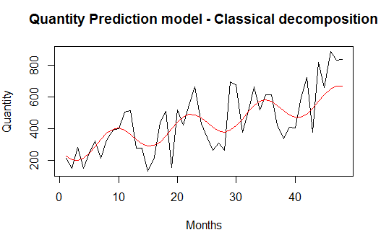
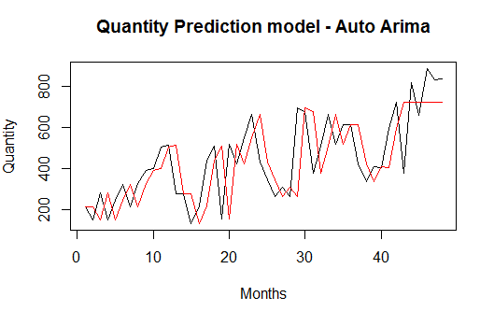
Quantity sold time series (Consumer APAC)
For Consumer APAC, the quantity prediction follows a wavy pattern.
The time series follows a increasing sales trend with random seasonality.
The classical decomposition model built for this has a MAPE value of 23.72372.
For Auto Arima, the MAPE value is 26.24458.

Slide 9
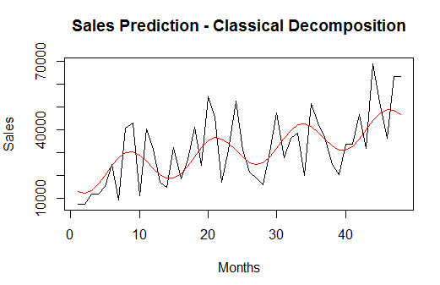
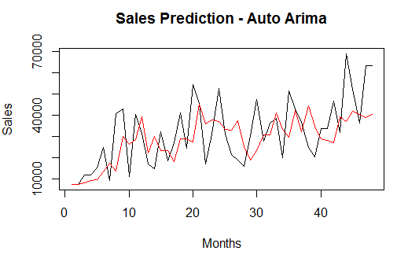
Sales Revenue Time Series (Consumer EU)
For Consumer EU, the sales prediction follows a wavy pattern.
The time series follows a increasing sales trend with random seasonality.
The classical decomposition model built for this has a MAPE value of 25.73527.
For Auto Arima, the MAPE value is 28.9226

Slide 10
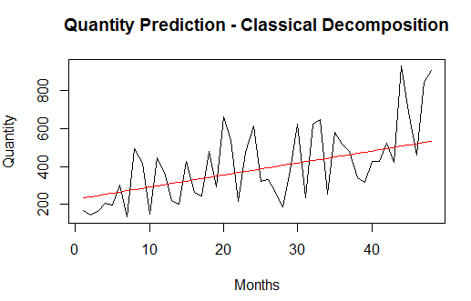
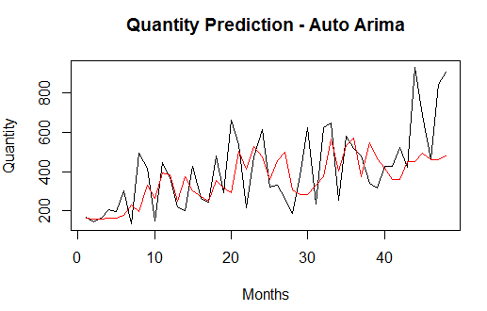
Quantity sold time series (Consumer EU)
For Consumer EU, the quantity prediction follows a linear pattern.
The time series follows a increasing sales trend with random seasonality.
The classical decomposition model built for this has a MAPE value of 30.22128.
For Auto Arima, the MAPE value is 30.13319.

Slide 11
Time Series Analysis and Forecasting

Slide 12
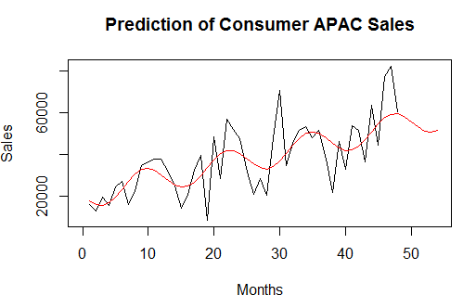
Consumer APAC Sales Prediction – 6 months
The Consumer APAC sales prediction for the next 6 months is
$320,156.5

Slide 13
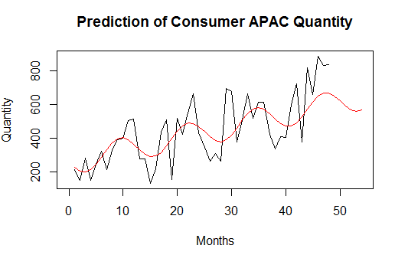
Consumer APAC Quantity Prediction – 6 months
The Consumer APAC quantity prediction for the next 6 months is 3552

Slide 14
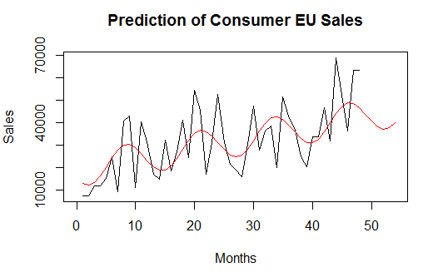
Consumer EU Sales Prediction – 6 months
The Consumer EU sales prediction for the next 6 months is $238,082.5

Slide 15
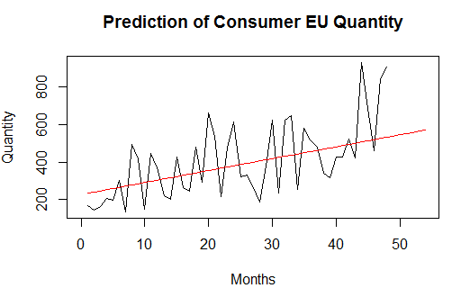
Consumer EU Quantity Prediction – 6 months
The Consumer EU quantity prediction for the next 6 months is 3328

